Slide 1

Wine For newbies
Data Analytics and Visualization Bootcamp Final Project

Slide 2

table of contents
01
02
03
Selec Topic
The Dataset
Data Exploration
04
05
06
Analysis Phase
Machine Learning
Looking Ahead
Why Wine?
Wine Magazine
What does the data look like? What features are there?
Are there any trends and insights?
Is machine learning better than a sommelier?
Are there any improvements that can be made?

Slide 3

Project Description
I chose to explore data from Wine Magazine to determine if it is possible to recommend a bottle of wine for a novice wine drinker based on such things as price, rating, variety, region, and year.

Slide 4

01.
Selected Topic

Slide 5
Why Wine?
For this repository, I chose to explore a Wine Reviews dataset compiled from Wine Enthusiast magazine. I selected this topic because I am part of a group of wine enthusiasts but certainly no sommeliers. Since wine can be complicated and overwhelming, I wanted to create a fun and interactive way for beginners to discover new wines. With this idea in mind, I built a dashboard to recommend wines for a novice based on such things as price, rating, variety, country, and province. I also built a machine learning model to see if we could train it to rate wine like an experienced sommelier.

Slide 6

What Do We Want to Learn?
Can a machine learning model be trained to rate wines like an experienced sommelier?
What factor is the best predictor of rating?
Is there a year that stands out as the best?
What are the most popular varieties?
What varieties earn the highest ratings?
Are there any regional trends?

Slide 7
02.
The Dataset

Slide 8
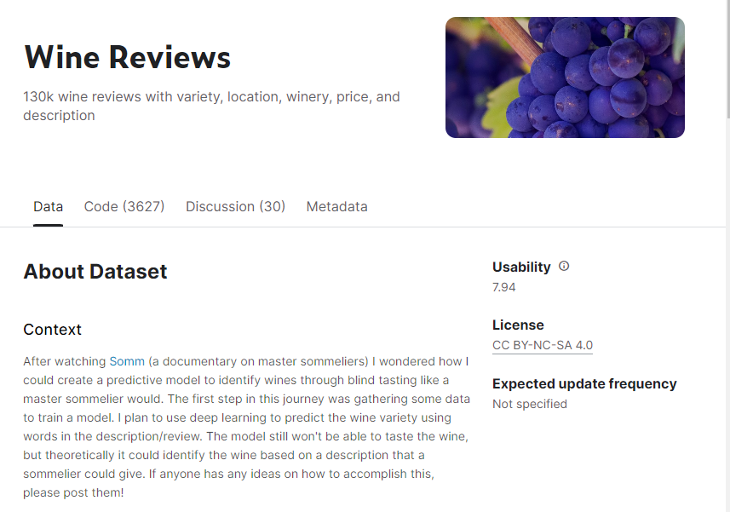
Kaggle - Wine Reviews

Slide 9
Data PoiNTs
Variety
Title
Province
Country
Price
Rating

Slide 10
03.
data Exploration

Slide 11
Data Transformation and adding 3 features:
Date format
The year was extracted from the title column
3
2
Clacification
A red or white designation was assigned by using information found in the variety, description and title columns
Binning
1
Ratings were grouped into 5 categories: below average, average, good, very good, and excellent

Slide 12
Core Cleaning & Transforming the Data
Goal 1
Goal 2
Null values in the region_1 column were replaced with the province name
Null values in the taster_name column were replaced with “unknown”
Goal 3
Goal 4
Dropped the description and designation columns
Dropped region_2 and taster_twitter_handle columns

Slide 13



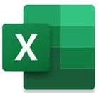






Technology Workflow

Slide 14
04.
Analysis Phase

Slide 15
How does the country affect rating and price?

Slide 16
Some Countries are not represented in White and Red categories

Slide 17
White vs. Red what are odds

Slide 18
If You Want a Good Red Go Pinot, White Go Chardonnay

Slide 19
Does Price really reflect quality?

Slide 20
Dashboard
Link to dashboard:

Slide 21
05.
Machine Learning

Slide 22
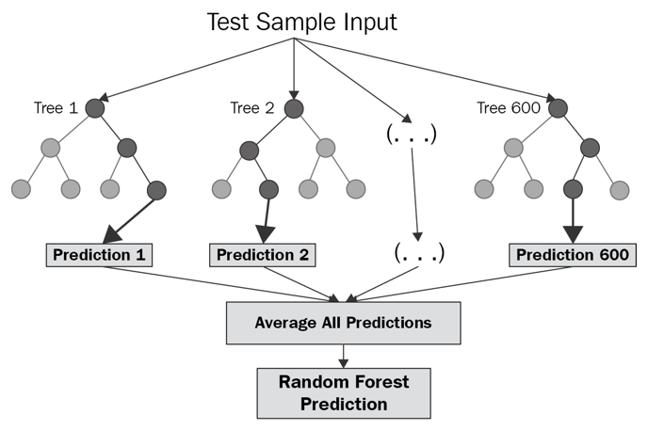
Machine Learning Model
A random forest model was chosen to handle our large categorical dataset while not overfitting to the training data.
The model was capped at 100 estimators (“trees”) as a compromise of computing time and accuracy

Slide 23
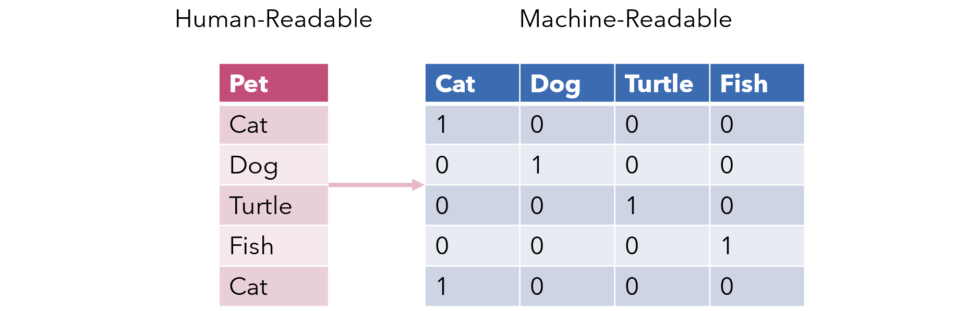
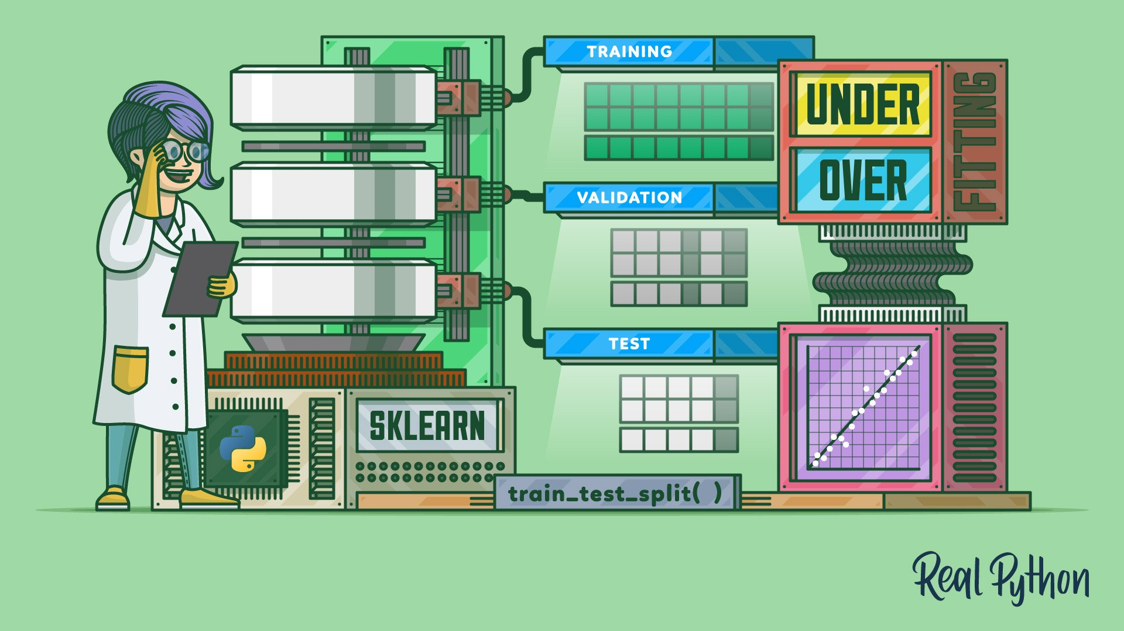
Preparing The Data With Scikit-Learn
One Hot Encoder was used to transform all categorical data into binary data that could be read by the model
Train Test Split was used to randomly split the data into 75% training and 25% testing data

Slide 24
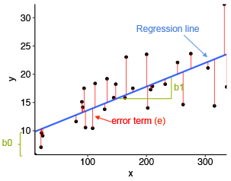
Results
The model scored a coefficient of determination (r²) value of .478 and a mean squared error (mse) value of 4.78 when predicting wine ratings
When predicting categories of wine ratings (below average, average, good, very good, and excellent), the model scored an r² value of .149 and an mse value of .109

Slide 25
06.
Looking Ahead

Slide 26
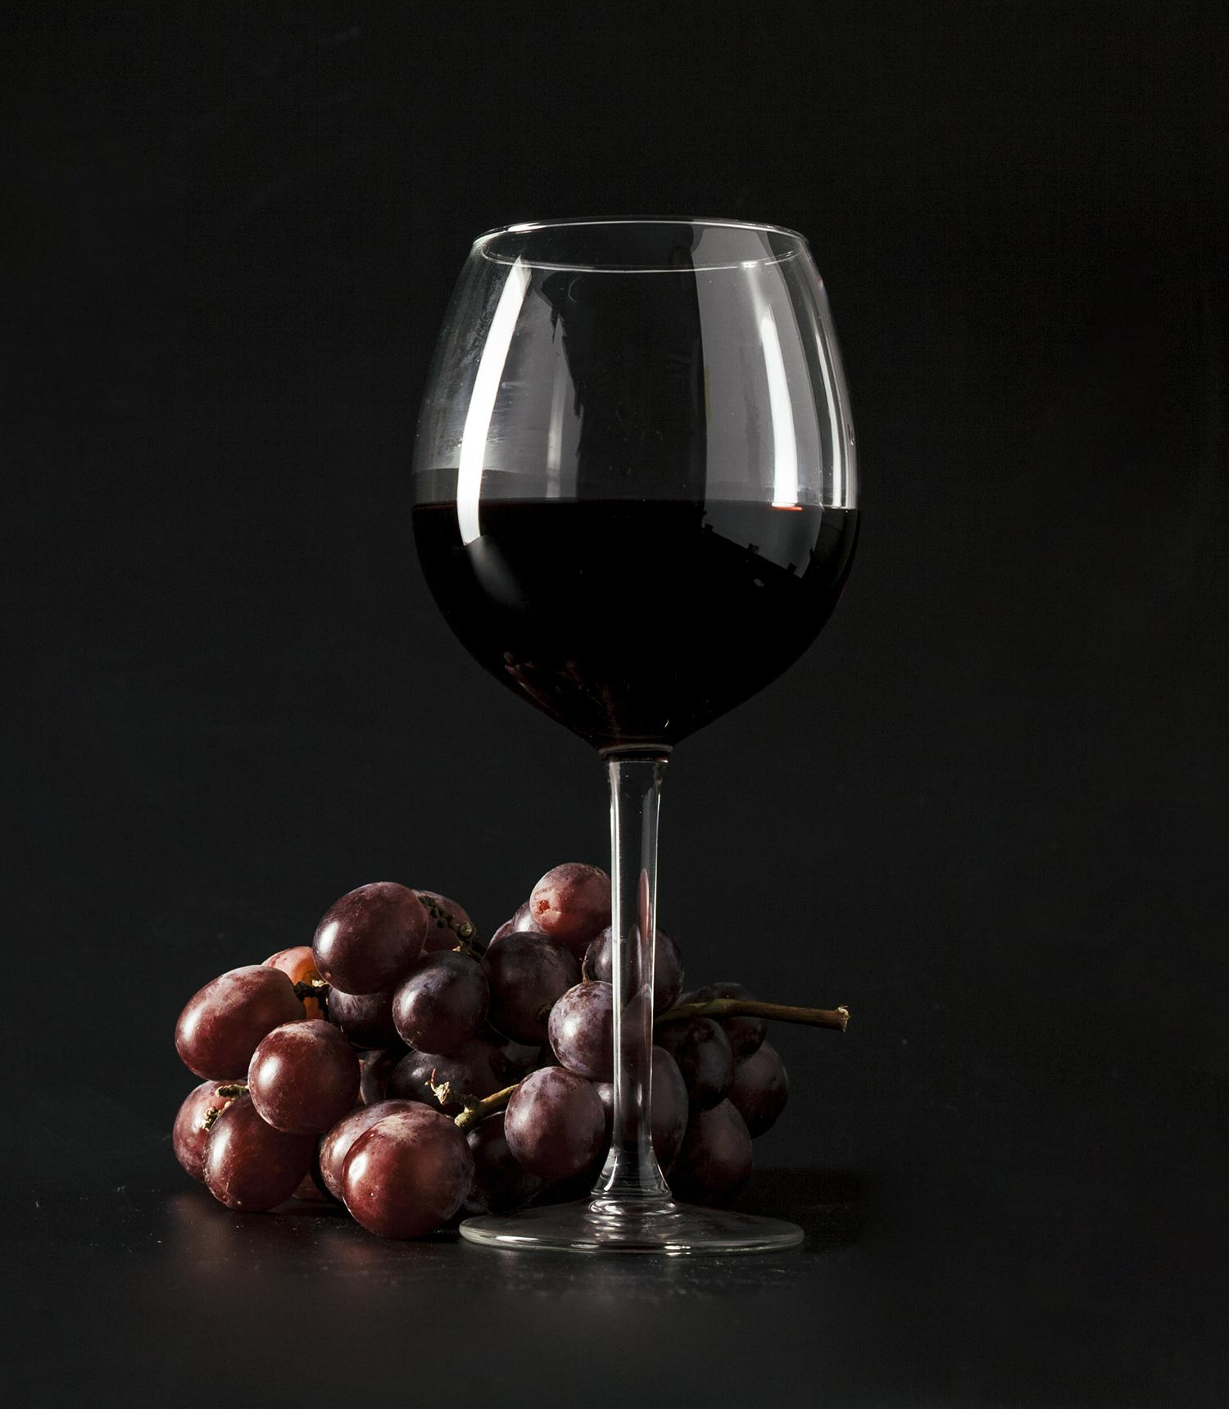
Possible Improvements
Utilize Description
More Wine Types
Either in the dashboard or our machine learning model
Extract more wine types from dataset like sparkling, dessert, etc.
Add Other Features
Deal with Outliers
Add harvest method or climate and weather data to improve our machine learning prediction
We had several outliers that negatively impacted our machine learning results

Slide 27

THANKS Do you have any questions?

